Slide 1
Single- and Multi-Layered Data Classification for Biomarker Discovery
Samuel Mueller
School of Mathematics and Statistics

Slide 2




Collaborators
School of Mathematics and Statistics
Jean Yang (CI)
Samuel Muller (CI)
Funded through ARC
DP130100488
Vertically integrated
statistical modelling in
multi-layered omics
studies

Slide 3


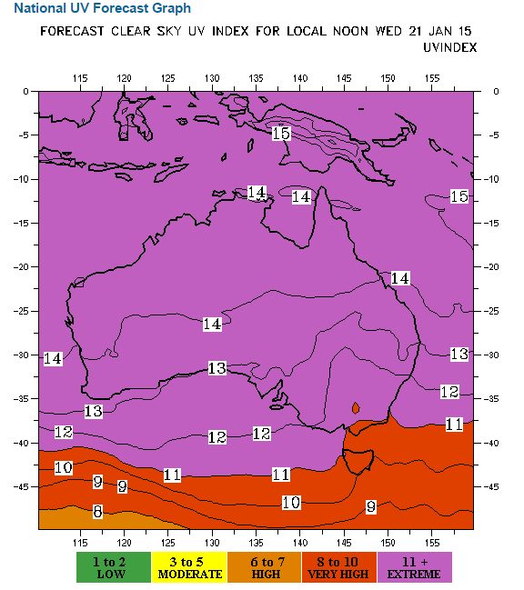
UV index on September 29, 2014
Sydney has approximately the same latitude as Los Angeles, just under 34º
Notes:
The UV index is on a linear scale, if it takes 30 minutes for a sun burn when the index is 6 then someone would burn in 15 minutes when the index is 12.

Slide 4
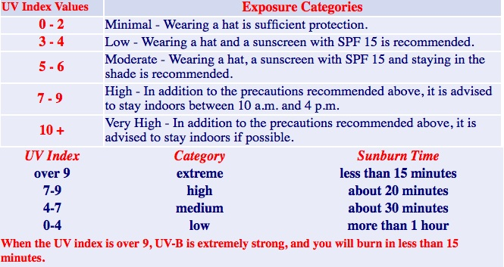
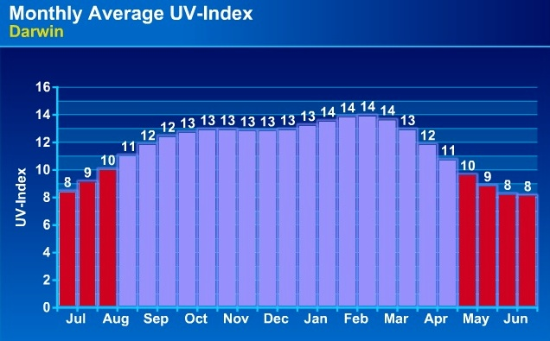
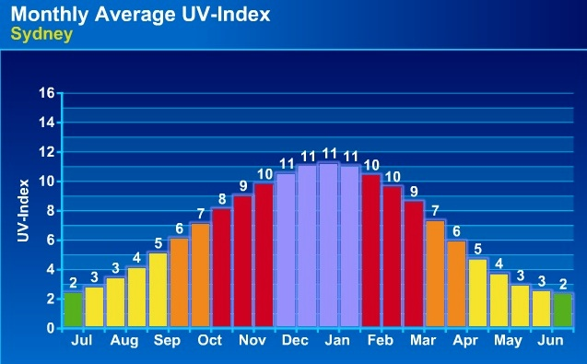
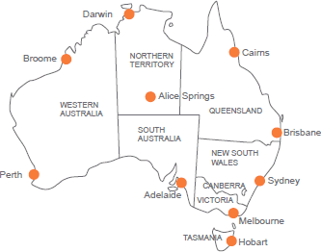
Monthly average UV-Index

Slide 5

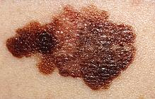
Melanomas
Melanomas are common in a large demographic of the population, especially in Caucasians living in sunny climates.
Of those that metastasise (Stage III), about 40% go on to live cancer free, but another 40% succumb to the disease in less than 1 year.
Samples were obtained from Professor Graham Mann's (third CI) group from the Westmead Institute for Cancer Research and Melanoma Institute, Australia (MIA).
Aim: To predict survival prognosis for Stage III melanoma patients.

Slide 6
Experimental data Stage III metastatic melanoma
Two survival groups
Poor prognosis Survival < 1 year and died due to melanoma
Good prognosis
Survival ≥ 4 years with no sign of relapse

Slide 7
Main messages
Each data platform (clinical, gene, protein) has its own challenges
Additive vertical integration is not automatically better
Error rate hunting
Interaction effects are difficult to find when p is large
‘Hard’ and ‘Easy’ classification helps to find interaction terms
Hierarchical classification

Slide 8
Experimental data First paper: Jayawardana et al (2015; IJCR)
84 Stage III
Melanoma specimens
GP: < 1 year died due to melanoma
PP: > 4 year with no sign of relapse
CPM
omics data
Clinico-pathologic
(n = 48)
BRAF / NRAS
Mutation status
(n = 48)
mRNA expression
(n = 47)
microRNA expression
(n = 45)
Protein (iTRAQ) expression
(n = 33)*
19 variables
2 variables
48802
probes
1347 sets of probes
8397 peptides
Notes:
We have a very rich data set, which has comparably many CPM (clinico-pathologic and mutation) variables and that is rather unusual about our data; here we try to explore that data as good as we can. The first paper on our data was just accepted for publication in the International Journal of Cancer Research.

Slide 9
Characteristics of our data
Detailed clinical and pathological data, with mutation status for majority of the patients
“Small” clinical data
Small relative to other cancer types
Large study of fresh tissue samples focusing on Stage III patients
Missing values
Vertical (omics) data = more genetic information on the same patients
Contrast to horizontal data = more patients with the same genetic information

Slide 10
Challenges in “vertical” integration
Small number of samples (large p, small n)
Sample mismatch (limited amount of tissues)
Understanding and processing many different platforms
Correlated information from multiple platforms
Unbalanced number of variables between CPM and high throughput omics platforms

Slide 11
Integration
Extreme variable reduction in omics data
Pre-validation (Tibshirani and Efron, 2002)
PCA based methods
CPM data
21 variables
omics
1 combined
variable

Slide 12
5-fold cross validation
Patients
Testing set
Classifier
Prediction error for testing set
Training set
Genes
Patient prediction errors
Training set
Testing set

Slide 13
5-fold cross validation
Patients
Testing set
Classifier
Prediction error for testing set
Training set
Genes
Patient prediction errors
Training set
Testing set

Slide 14
5-fold cross validation
Patients
Testing set
Classifier
Prediction error for testing set
Training set
Genes
Patient prediction errors
Training set
Testing set

Slide 15
5-fold cross validation
Patients
Testing set
Classifier
Prediction error for testing set
Training set
Genes
Patient prediction errors
Training set
Testing set

Slide 16
5-fold cross validation
Patients
Testing set
Classifier
Prediction error for testing set
Training set
Genes
Patient prediction errors
Training set
Testing set

Slide 17
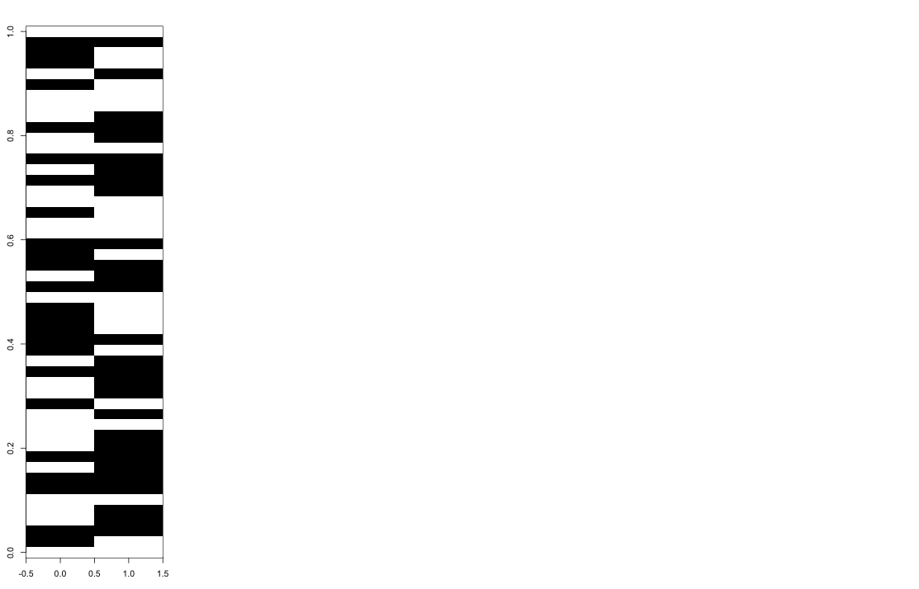
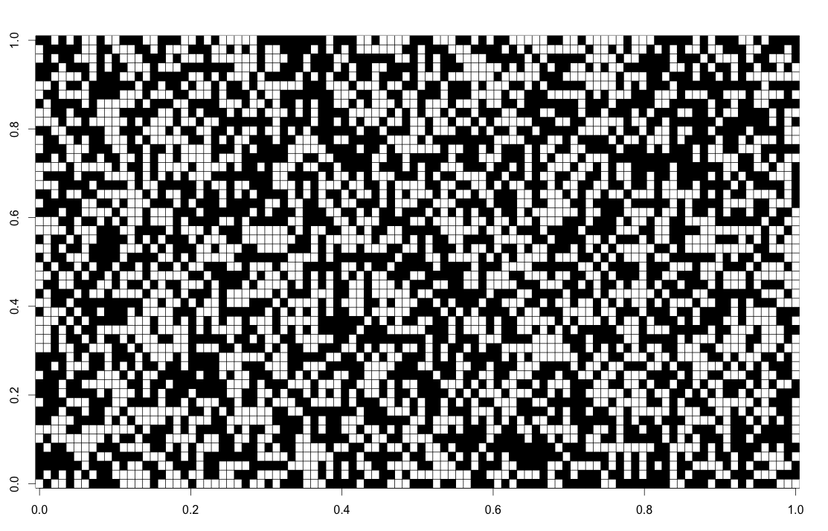
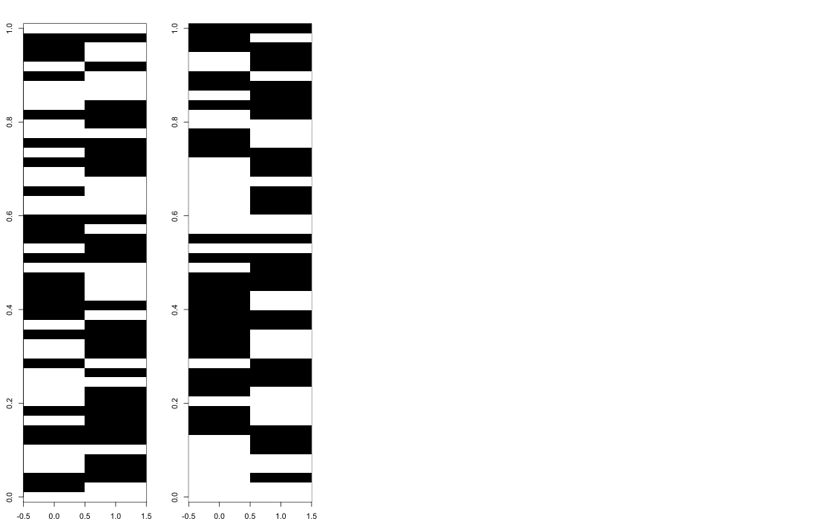
Repeated 5-fold cross validation
resamples
Patients
resample
5-fold CV
Patients
Patients
5-fold CV
Genes
100 resamples
5-fold CV
Average CV error
Learning set
Testing set
Notes:
Here Black = Classified wrongly
White = Classified correctly
Let’s think about understanding why certain columns are predominantly black, white and why are some mixed: Sample = column.
Conjecture: samples that are consistently misclassified (shown in white) could belong to some minority group

Slide 18
Classifiers
In our group we tried for the real data:
DLDA, LDA, random forest, pamr
logistic regression, lasso
many of these have been performed on multiple platforms, microarray, iTRAQ (protein) and miRNA microarray
efforts have also been made to integrate these datasets
network information has also been used in an attempt to stabilise the feature selection and also create different features (i.e. edges in a network, which is another way of potentially getting at interaction effects)
Notes:
DLDA classifies into that group such that the observation is closest to the average (across all genes/features) variance weighted square distance to the group mean
pamr is the r implementation of PAM by Tibshirani et al (2002) - classification from gene expression data, by the method of nearest shrunken centroids.

Slide 19
Error rate hunting The difficulty of getting error of comparable error rates
We often make many decisions before we start cross-validating
Analysis is rarely “blind”
Select the number of features
Select which features to use
Individual platform
Clinical: CPM
G: mRNA
P: protein
M: microRNA
Integration through
pre-validation
CPM + G
CPM + P
CPM + M
CPM + G + P + M
5-fold CV error rate
Jayawardana et al, IJC, 2015
Notes:
Talk through the various methods

Slide 20
Repeated 5-fold cross validation The 50 most DE genes and using DLDA
resample
Patients
5-fold CV
Patients
Patients
5-fold CV
Genes
100 resamples
5-fold CV
Average Patient CV
error
Learning set
Testing set
Notes:
Choose 50 most differentially expressed genes (most different fold changes) and then run DLDA (and of course the group tried lots of different things). Aside: this plot is just an illustration and does not show our real data.
Let’s think about understanding why certain columns are predominantly black, white and why are some mixed: Sample = column.
Conjecture: samples that are consistently misclassified could belong to some minority group

Slide 21
Samples that are easy and hard to classify
Patient specific prognostic error
For every patient we
can count how often we classify the patient incorrectly
Average patient error
Notes:
For each patient, going from left to right, the grey shows how often that patient was correctly classified. That is averaging out over the columns in the previous slide.

Slide 22
Another study: TCGA
A subset of samples from The Cancer Genome Atlas (TCGA) with the necessary clinico-pathologic annotation; stage III
mRNA
microRNA
Approximately 9 samples (33%) fall off the diagonal ➔ one data platform out-performed the other for these patients
Notes:
There is benefit of considering multiple ‘-omics’ platforms in predicting the survival outcome of patients.
Both mRNA and microRNA data perform well for a subset of patients, while for other groups, and/or individuals mRNA is the more accurate prognostic indicator cf. miRNA, and vice versa.
there are approximately 9 samples (33%) that fall off the diagonal, indicating that for these patients one data platform out-performed the other.
Further implicates the potential utility of multiple data platforms rather than one, when predicting the survival outcome of patients.

Slide 23
Summary so far …
Clinical features through mBMI approach
Clinical + mRNA gene expression works really well
Adding more than one omics platform did not perform as well as hoped
Different platforms are classifying different sets of patients correctly
Interaction effects are difficult to find when p is large
Notes:
Two sides of the same coin / even though we are gainning more information (edvident0 we are also
Limitation of the technologies (as well as methods associated with different platforms).

Slide 24
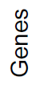

Motivating simulation example I
GP
PP
Major
Minor
Major
Minor
Notes:
n = 100,
p = 15
The color code is showing the expected expression level – for simplicity let’s assume that information in the genes has signals between -0.5 and 0.5 (normal with sd = 0.5)

Slide 25
Motivating simulation example I
GP
PP
Classification
Add some noise to the above expected expressions
Rank the genes by their ‘differential expressions’
Take the three most ‘differentially expressed’ genes
Perform a linear discriminant analysis (LDA)
Major
Minor
Major
Minor
Notes:
n = 100,
p = 15
The color code is showing the expected expression level – for simplicity let’s assume that information in the genes has signals between -0.5 and 0.5 (normal with sd = 0.5)

Slide 26
Motivating simulation example I
Majority class is better classified

Slide 27
Motivating simulation example I
GP
PP
Major
Minor
Major
Minor
Major
group
Notes:
n = 100,
p = 15
The color code is showing the expected expression level – for simplicity let’s assume that information in the genes has signals between -0.5 and 0.5 (normal with sd = 0.5)

Slide 28
Motivating simulation example I
GP
PP
Major
Minor
Major
Minor
Major
group
Minor group
Notes:
n = 100,
p = 15
The color code is showing the expected expression level – for simplicity let’s assume that information in the genes has signals between -0.5 and 0.5 (normal with sd = 0.5)

Slide 29
Motivating simulation example I
GP
PP
Major
Minor
Major
Minor
Major
group
Minor group
Classification
+ CV estimation
Classification
+ CV estimation
Notes:
n = 100,
p = 15
The color code is showing the expected expression level – for simplicity let’s assume that information in the genes has signals between -0.5 and 0.5 (normal with sd = 0.5)

Slide 30
Motivating simulation example I
Two classifiers are better than one
Major
group
Minor group
Classification
+ CV estimation
Classification
+ CV estimation
Notes:
Now, this was running classifications separately for the majority / minority group, and because we simulate, we know exactly what patient belongs to what group. Here and above we took the three most differentially expressed genes and did an LDA.

Slide 31
Motivating simulation example II
GP
PP
Major
Minor
Major
Minor
Notes:
n = 100,
p = 15
The color code is showing the expected expression level – for simplicity let’s assume that information in the genes has signals between -0.5 and 0.5 (normal with sd = 0.5)

Slide 32
Motivating simulation example II
Majority class is better classified

Slide 33
Motivating simulation example II
GP
PP
Major
Minor
Major
Minor
Notes:
n = 100,
p = 15
The color code is showing the expected expression level – for simplicity let’s assume that information in the genes has signals between -0.5 and 0.5 (normal with sd = 0.5)

Slide 34
Motivating simulation example I
GP
PP
Major
Minor
Major
Minor
Notes:
n = 100,
p = 15
The color code is showing the expected expression level – for simplicity let’s assume that information in the genes has signals between -0.5 and 0.5 (normal with sd = 0.5)

Slide 35
Recall – Experimental data Stage III metastatic melanoma
Two survival groups
Poor prognosis
Survival < 1 year and died due to melanoma
Good prognosis
Survival ≥ 4 years with no sign of relapse

Slide 36
Recall - Experimental data
84 Stage III
Melanoma specimens
GP: < 1 year died due to melanoma
PP: > 4 year with no sign of relapse
CPM
omics data
Clinico-pathologic
(n = 48)
BRAF / NRAS
Mutation status
(n = 48)
mRNA expression
(n = 47)
microRNA expression
(n = 45)
Protein (iTRAQ) expression
(n = 33)*
19 variables
2 variables
48802
probes
1347 sets of probes
8397 peptides
Notes:
mRNA : data not available
miRNA : 2 insufficient tissue.

Slide 37
Patient accuracy Results from Jayawardana et al (2015; IJCR)
45 samples (excluding protein data)
GP
PP
Clinical_AJCC
CPM
mRNA
microRNA
CPM + mRNA
CPM + microRNA
Samples
Clinical_AJCC = 4 AJCC variables: 1. Ulceration, 2. thickness of the primary tumour, 3. number of metastatic nodes and 4. nodal size.
37

Slide 38
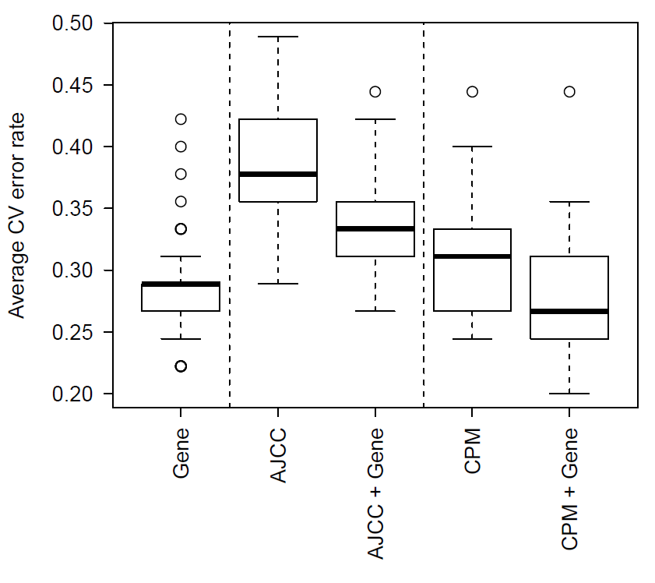
So what is wrong?
Samples may be “mislabelled” as Good Prognosis and Poor Prognosis
Classification unlikely to be through simple additive models
For example, we have variables that explain variation in some samples, but not all
Notes:
HERE: y-axis shows the average classification error rate across all patients for one of the 100 5-fold CV runs when using DLDA = Diagonal Linear Discriminant Analysis, assuming the correlation structure is diagonal (genes are not correlated) for the first boxplot and using logistic regression for AJCC using all four and CPM using variables from a outside selection (e.g. forward stepwise using AIC).
Answer interaction effects.
Hard to search for in high dimensional space.
Look for ‘simple’ interactions

Slide 39
Samples that are hard to classify
resample
Patients
5-fold CV
Patients
Patients
5-fold CV
Genes
100 resamples
5-fold CV
Average patient
accuracy
Learning set
Testing set
Notes:
Here Black = Classified wrongly
White = Classified correctly
Let’s think about understanding why certain columns are predominantly black, white and why are some mixed: Sample = column.
Conjecture: samples that are consistently misclassified (shown in white) could belong to some minority group

Slide 40
Samples that are hard to classify
resample
Patients
5-fold CV
Patients
Patients
5-fold CV
For every patient we can count how often we classify the patient incorrectly
Patient specific error
Hard vs easy samples
Genes
100 resamples
5-fold CV
Average patient
accuracy
Learning set
Testing set
Notes:
Here Black = Classified wrongly
White = Classified correctly
Let’s think about understanding why certain columns are predominantly black, white and why are some mixed: Sample = column.
Conjecture: samples that are consistently misclassified (shown in white) could belong to some minority group

Slide 41
Patient CV error as new response
Patient specific prognostic error
For every patient we
can count how often we classify the patient incorrectly
Average patient error
new y
Notes:
For each patient, going from left to right, the grey shows how often that patient was correctly classified. That is averaging out over the columns in the previous slide.

Slide 42
Regression output
y = number of correctly classified bootstrap samples under the mRNA (gene expression) platform
Design matrix X takes values from clinical variables.
Variable | Estimate | SD | t | p-value
Intercept | 0.23 | 0.76 | 2.98 | 0.005
Extranodal growth (Tum_Extranodal) | 0.37 | 0.12 | 3.22 | 0.002
Number of invasive nodes (Tum_Nodes) | -0.02 | 0.01 | -2.04 | 0.050
Notes:
Here (although we should do this differently in the future), using the average classification error as the new y (new response) we run a linear regression (which of course is not ideal and we should have worked on either transformed y’s or using nonlinear regression models) and run forward stepwise with AIC. Extranodal is dichotomous and Number of invasive nodes is integer valued 0 to 10+

Slide 43
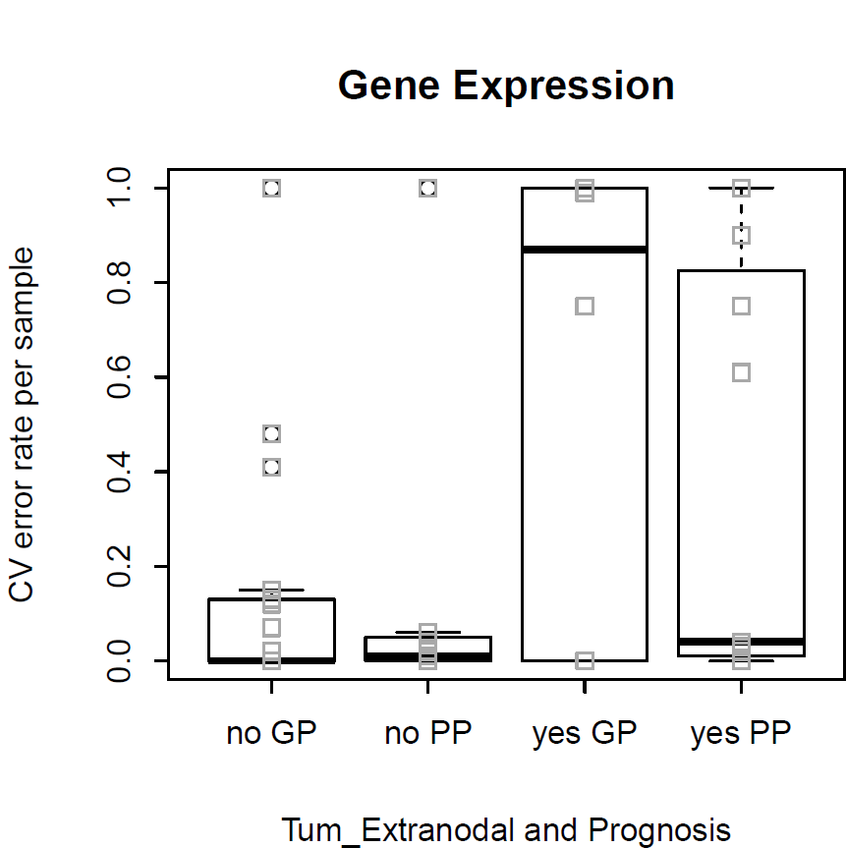
‘Hard’ and ‘Easy’ to classify samples
Patient specific error rate
Tum_Extranodal
(No)
Tum_Extranodal
(Yes)
Notes:
Here the same classifier is used and we clearly see that when using Gene’s the no group is easy to classify and the yes group is hard

Slide 44
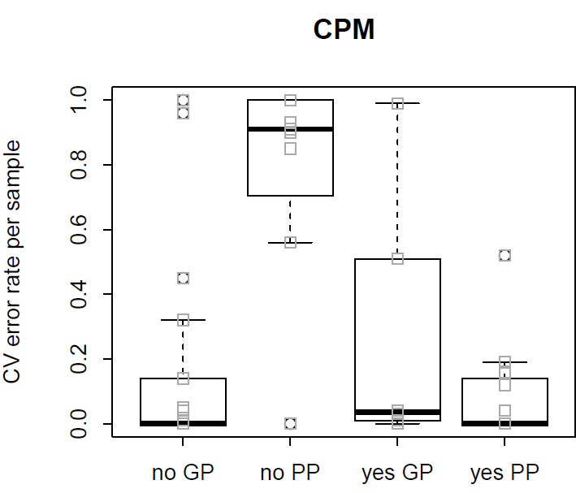
‘Hard’ and ‘Easy’ to classify samples
Patient specific error rate
Patient specific error rate
Tum_Extranodal
(No)
Tum_Extranodal
(Yes)
Tum_Extranodal
(No)
Tum_Extranodal
(Yes)
Notes:
On the other hand, if we use CPM as in Kaushala’s paper, then we do well in the yes group but we sacrifice performance in the “no PP” group.
Therefore, we identify “Tumor extranodal” as a potential interaction term and promises to improve performance when working with either the genes or the cpm only.

Slide 45
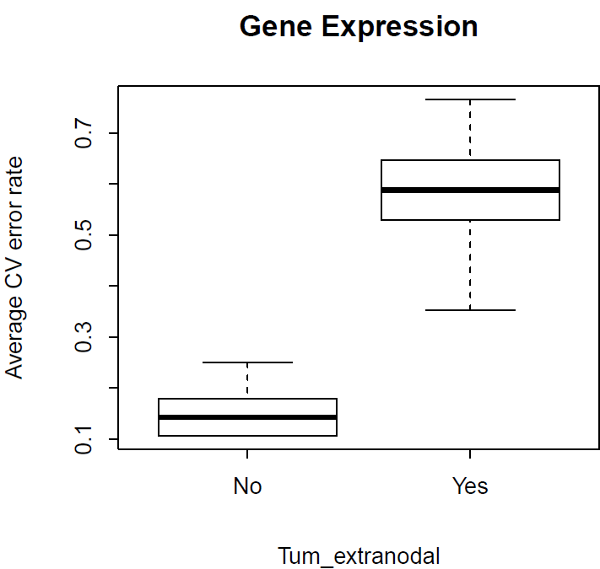
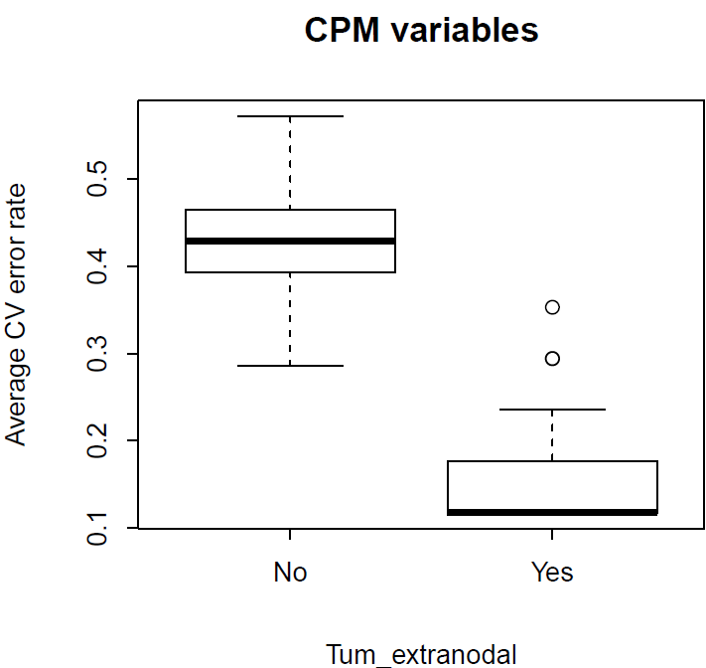
CV error of split within Tumor Extranodal Results for two classifiers
Notes:
Interestingly we don’t really do much better with the genes and performance is reversed with CPM. Ideally we should use a classifier based on the Genes only for the no Tumor Extranodal group and based on CPM only for the yes group. However, that decision is not cross-validated and underlines the challenge intrinsic with trying to minimise CV error rates.
Suggests no sub groups and minimal mislabelling
Going back to the rowmeans, however, classification is based on only those patients (samples) who had Tum_extranodal = No in the left boxplot and yes in the right.
The boxplot is for 100 5-fold-CV repeats to classify into GP and PP.
Because of the different behaviour, we see now clearly that Tum_extranodal should be used as a interaction term when combining it with either Gene Expression or CPM.
If we had a reduction in CV error in both boxplots within Gene Expression say, then it is clear that we need to have two different classifiers for the No and Yes patients respectively, i.e. an interaction term within Gene expression

Slide 46
Where has this lead us?
Hierarchical two stage procedure
Easy
Hard
In practice:
Use readily available CPM variables for the tumors with extranodal growth (Tum_Ext) to split samples.
Perform classification based on gene expression for tumors without extranodal growth (Tum_Extranodal = NO)
Clinical
variables
?
Patients
PP
GP
Use other molecular platforms?
Surgical or treatment related data?
mRNA

Slide 47
Main messages
Each data platform has its own challenges
Additive vertical integration is not automatically better
Error rate hunting
Interaction effects are difficult to find when p is large
‘Hard’ and ‘Easy’ classification helps to find interaction terms
Hierarchical classification

Slide 48
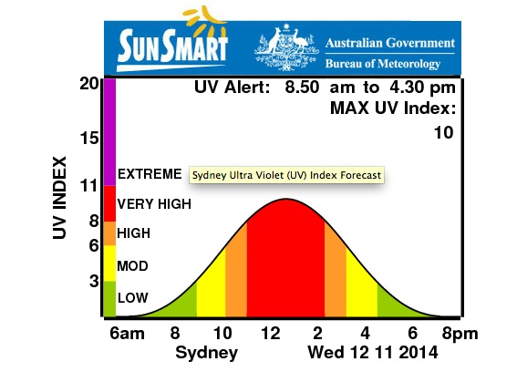
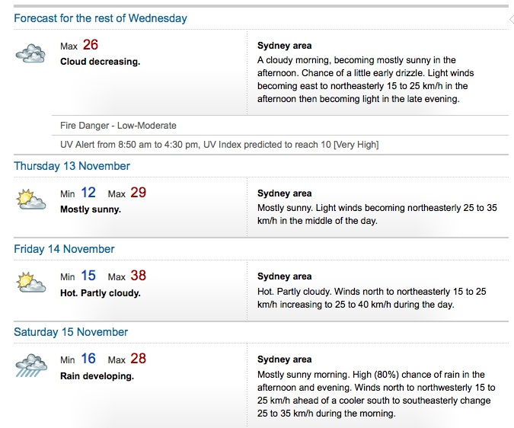
UV index on November 12, 2014

Slide 49



Acknowledgements
School of Mathematics and Statistics (Usyd)
Jean Yang
Samuel Muller
Kaushala Jayawardana
John Ormerod
Dario Strbenac
Rebecca Barter
Shila Ghazanfar
Melanoma program at MIA/WMI/RPA
Graham Mann (Usyd)
Gulietta Pupo
Varsha Tembe
Sara-Jane Schramm
John Thompson
Richard Scolyer (RPA)
Notes:
1 – primary supervisor gm at usyd, and associate supervisor mw at unsw and sbi
2 – prof rs and his team provide the samples and assoc. clinic-path data
3 – high-throughput assays performed by GP and VT, SM
4 – ac, jy, vj – provided statistical analysis and interpretation
5 – team at SBI for generous hosting and patience in helping me learn about systems biology
6 – ongoing work with many of these people

Slide 50
Thankyou

